Slide 1
What is geography

Slide 2
So what is geography?
Geography is about everything that’s going on, in places all over the planet .... Right at this moment
The world can be confusing, but Geography will help you make sense of it.
Geography is a BIG subject.
What is Geography?

Slide 3
What is geography?
Geography is the science that studies the surface of the earth and the area just above and just below the Earth’s surface.
It is concerned with PHYSICAL features such as climate, rivers and forests.
Geography also looks at how HUMANS use the planet and includes settlement, industry, farming and population.
ENVIRONMENTAL geography looks at the surroundings in which people, plants and animals live and includes resources and conservation.

Slide 7
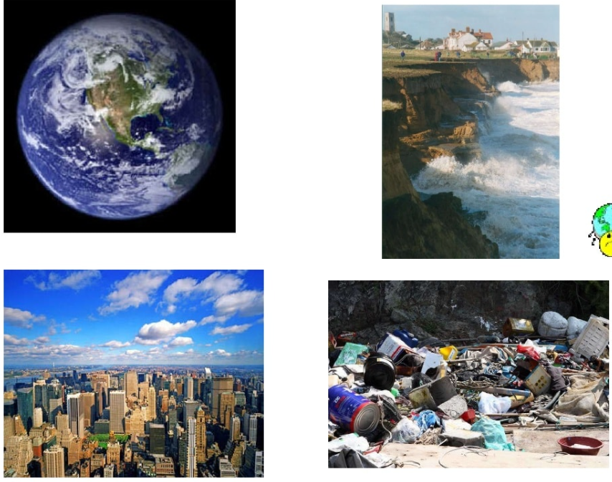
1
3
2
4

